Slide 1


POWERPOINT
RAPIDPPT
Shanghai Rapidesign Advertising Co.,ltd, http://www.rapidesign.cn, http://www.rapidppt.com, 4006018802.
上海锐普广告有限公司
通用型PPT模板
Shanghai Rapidesign Advertising Co.,ltd
www.rapidppt.com

Slide 2
此模板适用于商务、汇报、总结、展示及相关类别演示，红灰欧美简约风格，颜色商务大气，版式简洁明了，内页延续封面，使整个PPT统一一致。
Design Concept
设计理念
模板内颜色可以替换为自己的颜色，图片也可以替换为自己的图片。图表以简单实用、易修改为设计原则，从配色到版式都精益求精，满足您不同场合的需要。字体已经嵌入，请放心使用，祝您成功!

Slide 3

Contents
目录
点击添加标题
Add a title
点击添加标题
Add a title
点击添加标题
Add a title
点击添加标题
Add a title

Slide 4
Contents
目录
点击添加标题
Add a title
点击添加标题
Add a title
点击添加标题
Add a title
点击添加标题
Add a title

Slide 5


点击添加标题
Add a title
上海锐普广告有限公司是中国第一家精品PPT设计机构。拥有国内顶尖的PPT制作技术、顶级的PPT设计团队，坚持精益求精、拒绝平庸的做事精神，帮助您实现美观、精致、严谨、动感的PPT展示效果，让您的PPT创造卓越价值
RAPIDPPT, the leader of professional PPT designer in China.
5years of making professional PPT, 500 case studies for the classical PPT, make sure you will be satisfied. ……RAPIDPPT differs from the traditional production model, and create a new PPT experience.

Slide 6
点击添加标题
Add a title
1
1
1
1
2
3
点击添加标题
Add a title
点击添加标题
上海锐普广告有限公司是中国第一家精品PPT设计机构。拥有国内顶尖的PPT制作技术、顶级的PPT设计团队，坚持精益求精
5years of making professional PPT, 500 case studies for the classical PPT, make sure you will be satisfied
上海锐普广告有限公司是中国第一家精品PPT设计机构。拥有国内顶尖的PPT制作技术、顶级的PPT设计团队，坚持精益求精

Slide 7



点击添加标题
Add a title
1
1
1
1
2
3
添加标题
Add a title
添加标题
拥有国内顶尖的PPT制作技术、顶级的PPT设计团队，坚持精益求精
5years of making professional PPT, 500 case studies for the classical PPT.
拥有国内顶尖的PPT制作技术、顶级的PPT设计团队，坚持精益求精

Slide 8
点击添加标题
Add a title

Slide 9
点击添加标题
Add a title
上海锐普广告有限公司是中国第一家精品PPT设计机构。拥有国内顶尖的PPT制作技术、顶级的PPT设计团队，坚持精益求精、拒绝平庸的做事精神，帮助您实现美观、精致、严谨、动感的PPT展示效果，让您的PPT创造卓越价值
RAPIDPPT, the leader of professional PPT designer in China.
5years of making professional PPT, 500 case studies for the classical PPT, make sure you will be satisfied. ……RAPIDPPT differs from the traditional production model, and create a new PPT experience.
点击添加内容
Add a content
点击添加内容
Add a content
点击添加内容
Add a content
点击添加内容
Add a content

Slide 10
点击添加标题
Add a title
点击添加内容
上海锐普广告有限公司是中国第一家精品PPT设计机构。拥有国内顶尖的PPT制作技术、顶级的PPT设计团队，坚持精益求精、拒绝平庸的做事精神，帮助您实现美观、精致、严谨、动感的PPT展示效果，让您的PPT创造卓越价值
Add content
5years of making professional PPT, 500 case studies for the classical PPT, make sure you will be satisfied. ……RAPIDPPT differs from the traditional production model, and create a new PPT experience.
?
点击添加内容

Slide 11

Contents
目录
点击添加标题
Add a title
点击添加标题
Add a title
点击添加标题
Add a title
点击添加标题
Add a title

Slide 12
点击添加标题
Add a title
POWERFUL
CREATIVE
PRETTY
LOGICAL
OUR SERVICE
点击添加标题
Add a title
上海锐普广告有限公司是中国第一家精品PPT设计机构。拥有国内顶尖的PPT制作技术、顶级的PPT设计团队，坚持精益求精、拒绝平庸的做事精神，帮助您实现美观、精致、严谨、动感的PPT展示效果，让您的PPT创造卓越价值
RAPIDPPT, the leader of professional PPT designer in China.
5years of making professional PPT, 500 case studies for the classical PPT, make sure you will be satisfied.
RAPIDPPT differs from the traditional production model, and create a new PPT experience.

Slide 13
点击添加标题
Add a title
点击添加标题
Add a title
上海锐普广告有限公司是中国第一家精品PPT设计机构。拥有国内顶尖的PPT制作技术、顶级的PPT设计团队，坚持精益求精、拒绝平庸的做事精神，帮助您实现美观、精致、严谨、动感的PPT展示效果，让您的PPT创造卓越价值
RAPIDPPT, the leader of professional PPT designer in China.
5years of making professional PPT, 500 case studies for the classical PPT, make sure you will be satisfied.
RAPIDPPT differs from the traditional production model, and create a new PPT experience.

Slide 14

点击添加标题
Add a title
拥有国内顶尖的PPT制作技术、顶级的PPT设计团队，坚持精益求精、拒绝平庸的做事精神
帮助您实现美观、精致、严谨、动感的PPT展示效果，让您的PPT创造卓越价值
RAPIDPPT differs from the traditional production model, and create a new PPT experience.
5years of making professional PPT, 500 case studies for the classical PPT, make sure you will be satisfied.

Slide 15
点击添加标题
Add a title
添加标题
Add a title
添加内容
Add content
Add content
添加内容
拥有国内顶尖的PPT制作技术、顶级的PPT设计团队，坚持精益求精、拒绝平庸的做事精神
帮助您实现美观、精致、严谨、动感的PPT展示效果，让您的PPT创造卓越价值
RAPIDPPT differs from the traditional production model, and create a new PPT experience.
5years of making professional PPT, 500 case studies for the classical PPT.

Slide 16

点击添加标题
Add a title
上海锐普广告有限公司是中国第一家精品PPT设计机构。拥有国内顶尖的PPT制作技术、顶级的PPT设计团队，坚持精益求精、拒绝平庸的做事精神，帮助您实现美观、精致、严谨、动感的PPT展示效果，让您的PPT创造卓越价值
RAPIDPPT, the leader of professional PPT designer in China.

Slide 17
Contents
目录
点击添加标题
Add a title
点击添加标题
Add a title
点击添加标题
Add a title
点击添加标题
Add a title

Slide 18
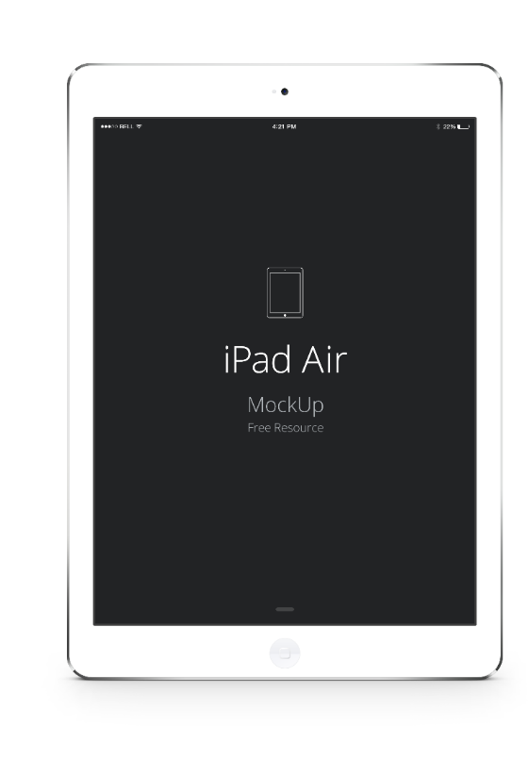

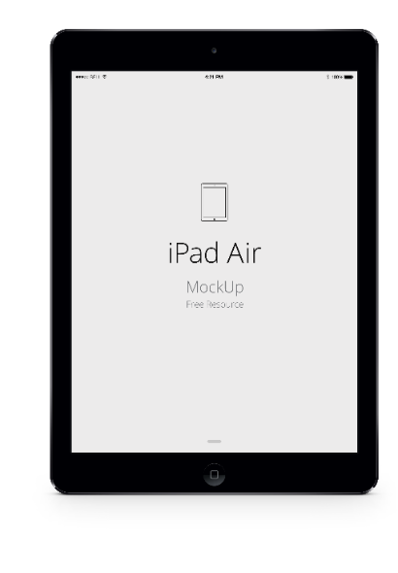

点击添加标题
Add a title
点击添加标题
Add a title
上海锐普广告有限公司是中国第一家精品PPT设计机构。拥有国内顶尖的PPT制作技术、顶级的PPT设计团队，坚持精益求精、拒绝平庸的做事精神，帮助您实现美观、精致、严谨、动感的PPT展示效果，让您的PPT创造卓越价值
RAPIDPPT, the leader of professional PPT designer in China.
5years of making professional PPT, 500 case studies for the classical PPT, make sure you will be satisfied.
RAPIDPPT differs from the traditional production model, and create a new PPT experience.

Slide 19
点击添加标题
Add a title
点击添加内容
Add content
点击添加内容
上海锐普广告有限公司是中国第一家精品PPT设计机构。拥有国内顶尖的PPT制作技术、顶级的PPT设计团队，坚持精益求精、拒绝平庸的做事精神，帮助您实现美观、精致、严谨、动感的PPT展示效果，让您的PPT创造卓越价值
点击添加标题
5years of making professional PPT, 500 case studies for the classical PPT, make sure you will be satisfied. ……RAPIDPPT differs from the traditional production model, and create a new PPT experience.

Slide 20
点击添加标题
Add a title
65%
添加标题
35%
Add a title
89%
添加标题
上海锐普广告有限公司是中国第一家精品PPT设计机构

Slide 21

点击添加标题
Add a title
添加标题 Add a title
RAPIDPPT, the leader of professional PPT designer in China.
5years of making professional PPT, 500 case studies for the classical PPT, make sure you will be satisfied. ……RAPIDPPT differs from the traditional production model, and create a new PPT experience.
www.rapidppt.com

Slide 22
点击添加标题
Add a title
点击添加标题
拥有国内顶尖的PPT制作技术、顶级的PPT设计团队，坚持精益求精、拒绝平庸的做事精神，帮助您实现美观、精致、严谨、动感的PPT展示效果，让您的PPT创造卓越价值
Add a title
Add a title
Add a title
500 case studies for the classical PPT, make sure you will be satisfied. ……RAPIDPPT differs from the traditional production model, and create a new PPT experience.
Add a title
Add a title

Slide 23
点击添加标题
Add a title
点击添加内容
点击添加标题
拥有国内顶尖的PPT制作技术、顶级的PPT设计团队， 坚持精益求精
点击添加内容
点击添加标题
点击添加内容
Add a title
5years of making professional PPT, 500 case studies for the classical PPT, make sure you will be satisfied.
点击添加内容

Slide 24
Contents
目录
点击添加标题
Add a title
点击添加标题
Add a title
点击添加标题
Add a title
点击添加标题
Add a title

Slide 25
点击添加标题
Add a title
添加标题
点击添加标题
Add a title
拥有国内顶尖的PPT制作技术、顶级的PPT设计团队，坚持精益求精、拒绝平庸的做事精神，帮助您实现美观、精致、严谨、动感的PPT展示效果，让您的PPT创造卓越价值
Add a title
5years of making professional PPT, 500 case studies for the classical PPT, make sure you will be satisfied. ……RAPIDPPT differs from the traditional production model, and create a new PPT experience.

Slide 26
点击添加标题
Add a title
1
2
1.点击添加标题
2.Add a title
拥有国内顶尖的PPT制作技术、顶级的PPT设计团队，坚持精益求精
5years of making professional PPT, 500 case studies for the classical PPT.

Slide 27

点击添加标题
Add a title
拼搏
上海锐普广告有限公司是中国第一家精品PPT设计机构，拥有国内顶尖的PPT制作技术、顶级的PPT设计团队
www.rapidppt.com

Slide 28
点击添加标题
Add a title
点击添加标题
Add a title
添加标题
Add a title
添加标题
Add a title
Add content
Add content
Add content
Add content
Add content
添加内容
Add content
添加内容
拥有国内顶尖的PPT制作技术、顶级的PPT设计团队，坚持精益求精、拒绝平庸的做事精神，帮助您实现美观、精致、严谨、动感的PPT展示效果，让您的PPT创造卓越价值
5years of making professional PPT, 500 case studies for the classical PPT, make sure you will be satisfied. ……RAPIDPPT differs from the traditional production model, and create a new PPT experience.

Slide 29
THANK YOU
RAPIDPPT
Shanghai Rapidesign Advertising Co.,ltd, http://www.rapidesign.cn, http://www.rapidppt.com, 4006018802.
谢谢观看
通用型PPT模板

